Slide 1
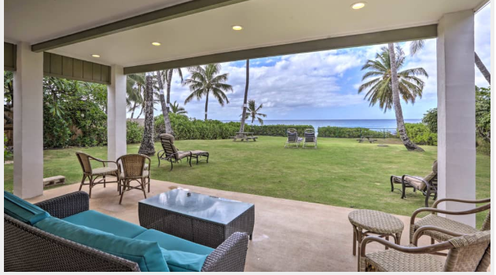

Group 1
Analysis of Airbnb in Hawaii
Jolinda Dirks : Pam Garner : Connie Conine : James Mitchell

Slide 2
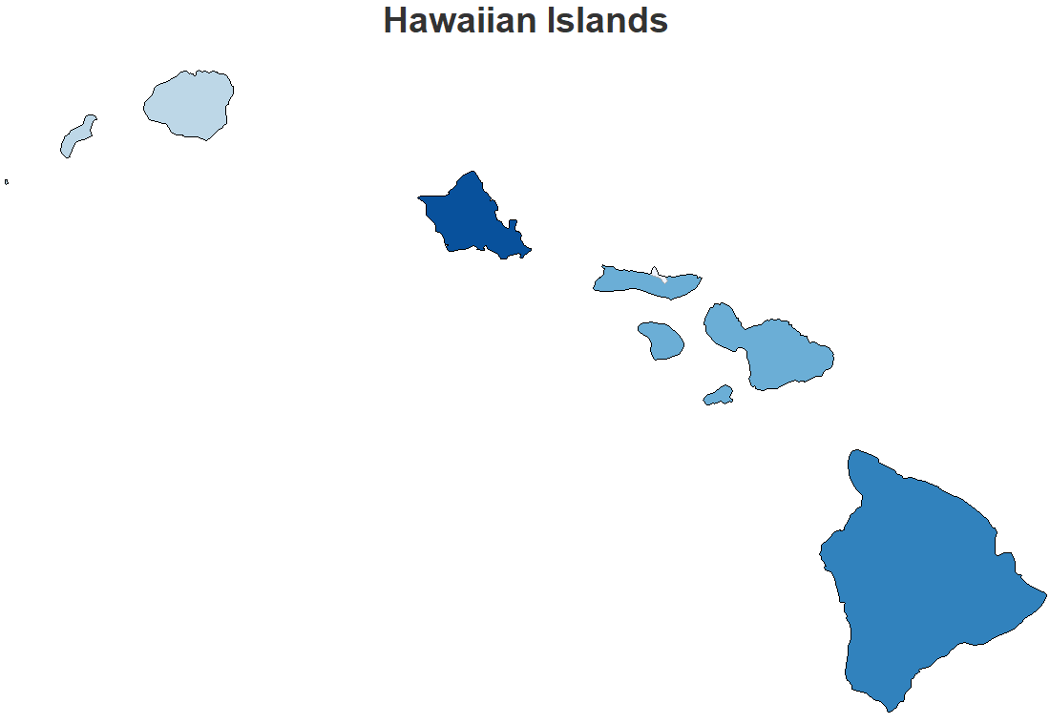
Agenda
Airbnb Summary
Superhost
BeachFront
Hawaii
Top Five Recommendations

Slide 3

Airbnb Summary

Slide 4
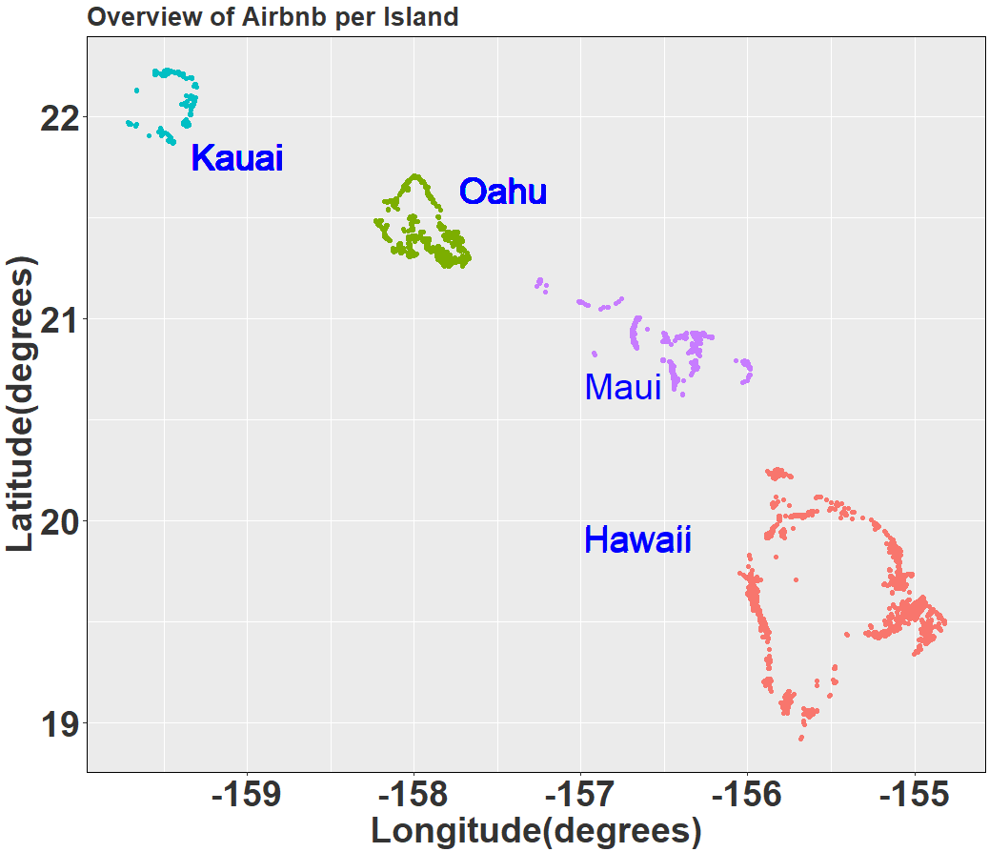
Airbnb Summary
Islands
Kauai
Oahu
Maui
Hawaii
Airbnb per Island
Kauai | Oahu | Maui | Hawaii | Total
2205 | 5051 | 4977 | 4385 | 16,618

Slide 5
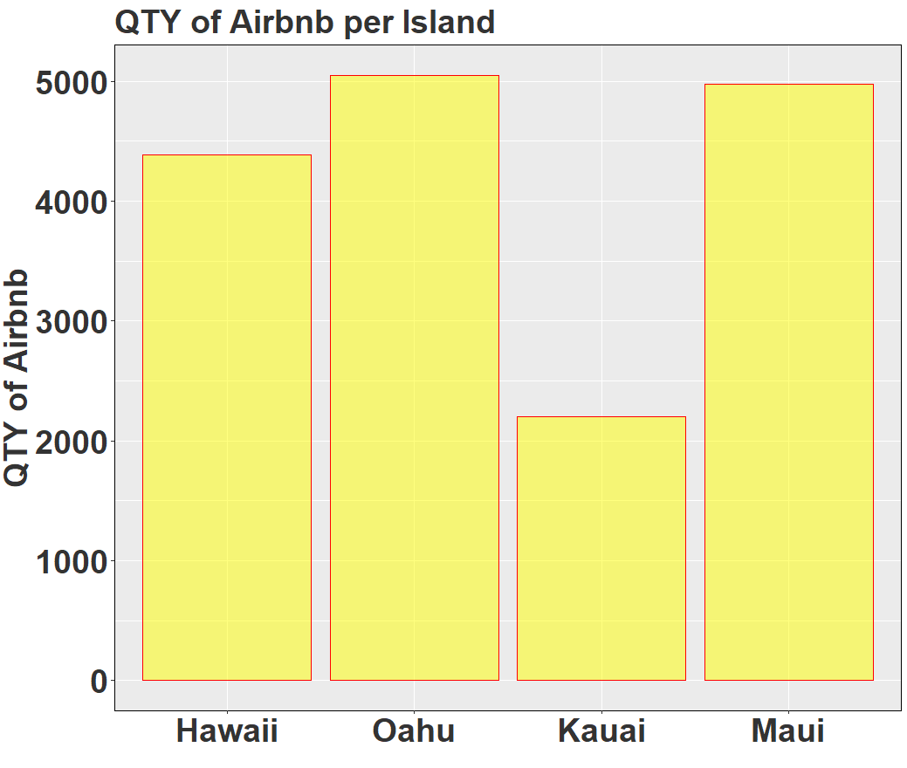
Airbnb Summary
Airbnb per Island
Kauai | Oahu | Maui | Hawaii | Total
2205 | 5051 | 4977 | 4385 | 16,618

Slide 6
Superhost

Slide 7

Superhost
Distinguishing feature among Airbnb

Slide 8
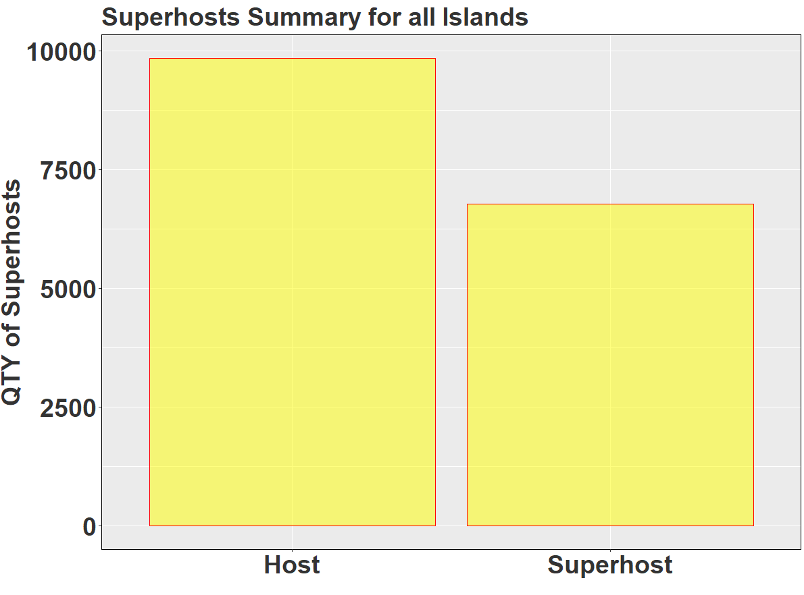
Superhost Summary for all Islands
Host | Superhost
9,842 | 6,776

Slide 9

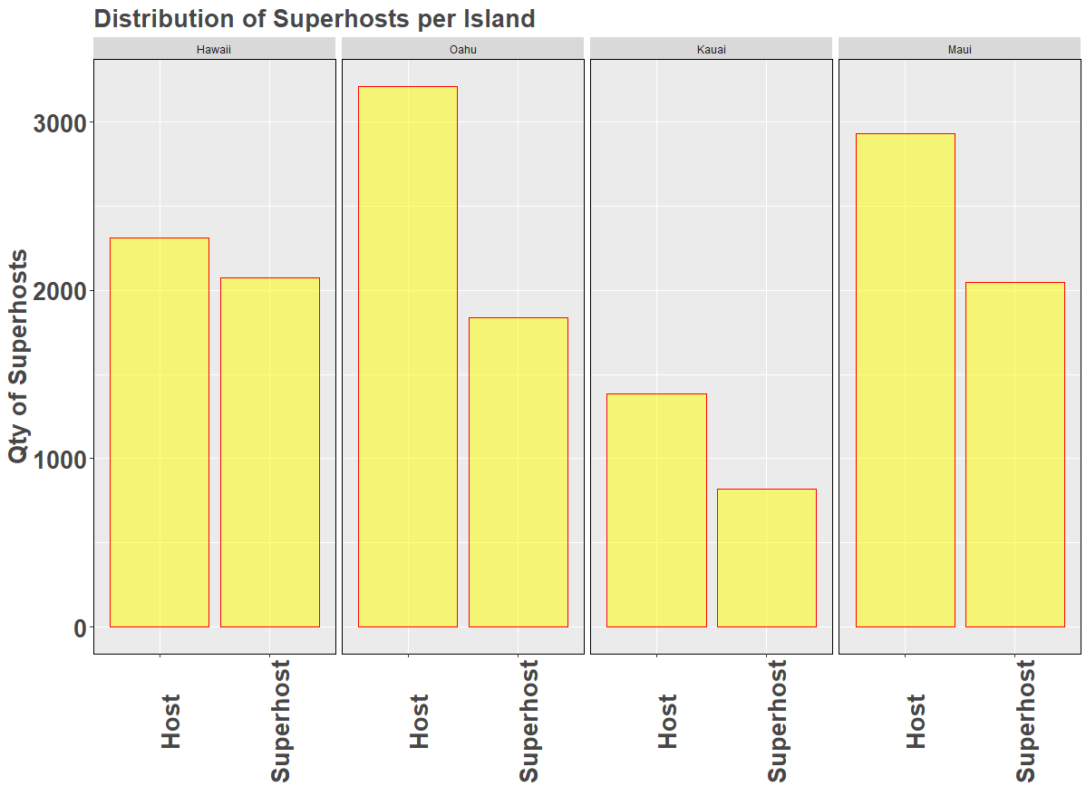
SuperHosts per Island

Slide 10
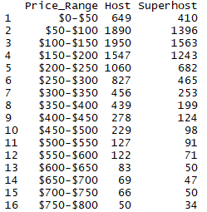
Quantity of Superhosts per Price Bin
Price Bin[$100:$150] has most Superhosts

Slide 11
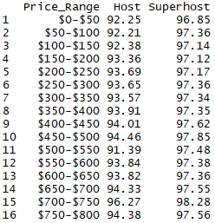
Ratings for Superhosts per Price Bin
Ratings increase by 5% for Superhosts

Slide 12
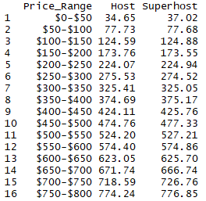
Average Price for Superhosts per Price Bin
No difference in Average price

Slide 13
BeachFront
Notes:
Aren’t you VP Student Life?

Slide 14
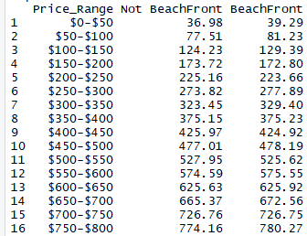
Price per Proximity to Beach
Superhosts slightly more expensive closer to beach

Slide 15
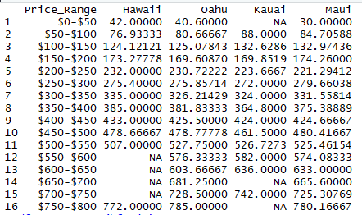
Price per Proximity to Beach across all Islands and Superhost
Hawaii is slight less expensive

Slide 16
Hawaii
Notes:
Aren’t you VP Student Life?

Slide 17
SUBSETTED DATA
Airbnb for all Islands
16,618
6,776
39
2,073
937
Superhost
Hawaii
Beachfront
$100-$150
There are 39 Airbnb in Hawaii categorized as Superhosts and BeachFront in the Price Range of [$100:$150].

Slide 18
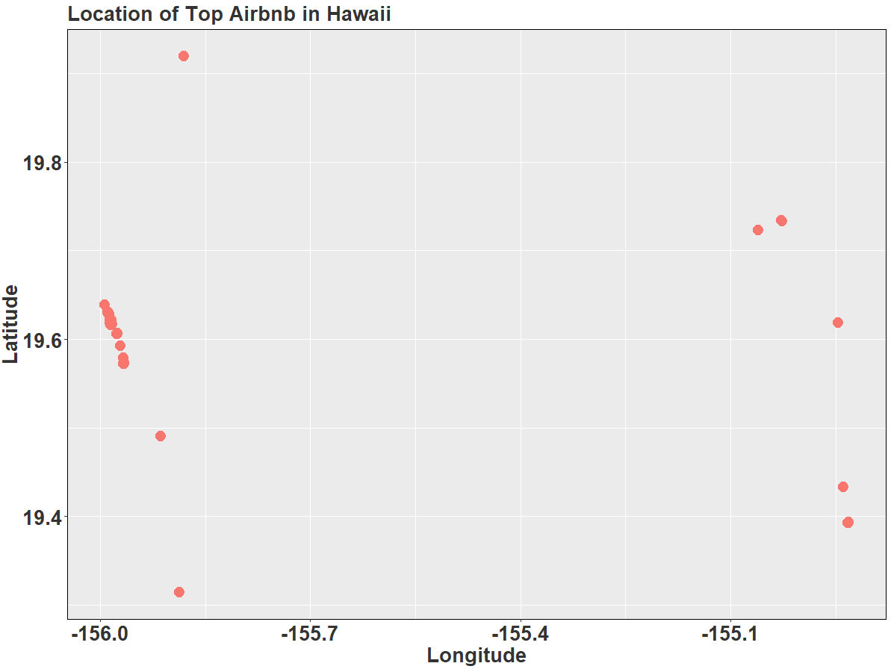
Hawaii : Location
Hawaii has 39 Superhost/BeachFront/[100:200]

Slide 19
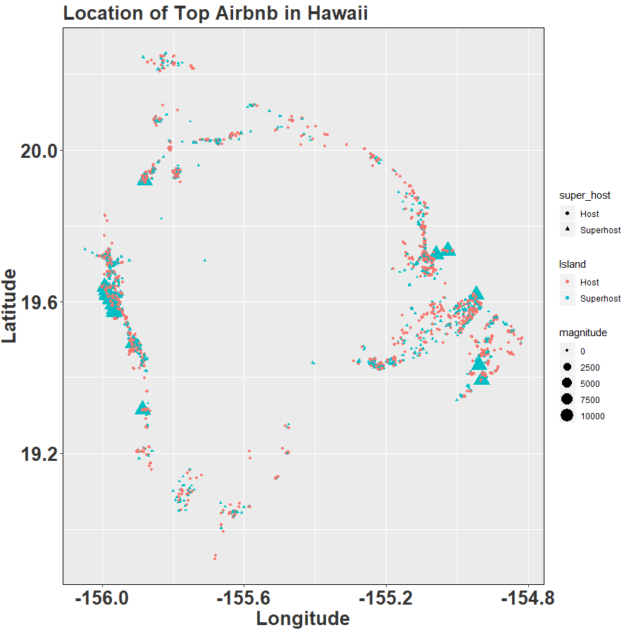
Hawaii : Location
Hawaii has 39 Superhost/BeachFront/[100:200]

Slide 20
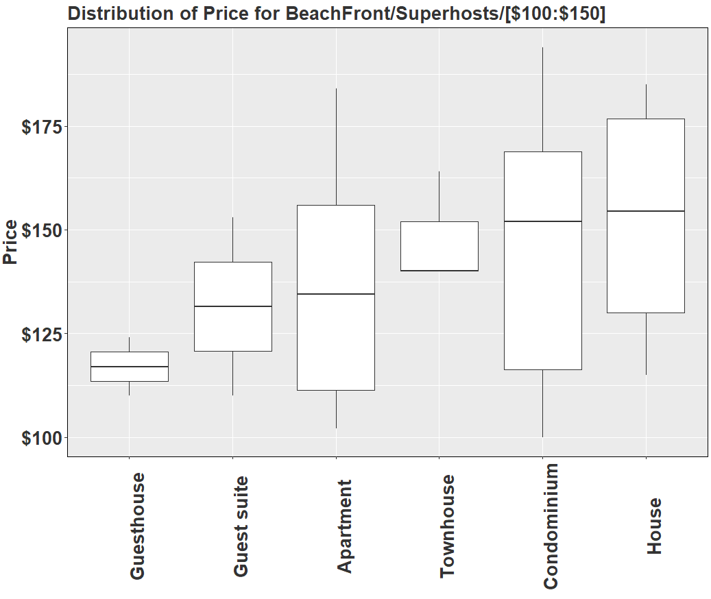
Hawaii : Price Distribution PER PROPERTY TYPE

Slide 21
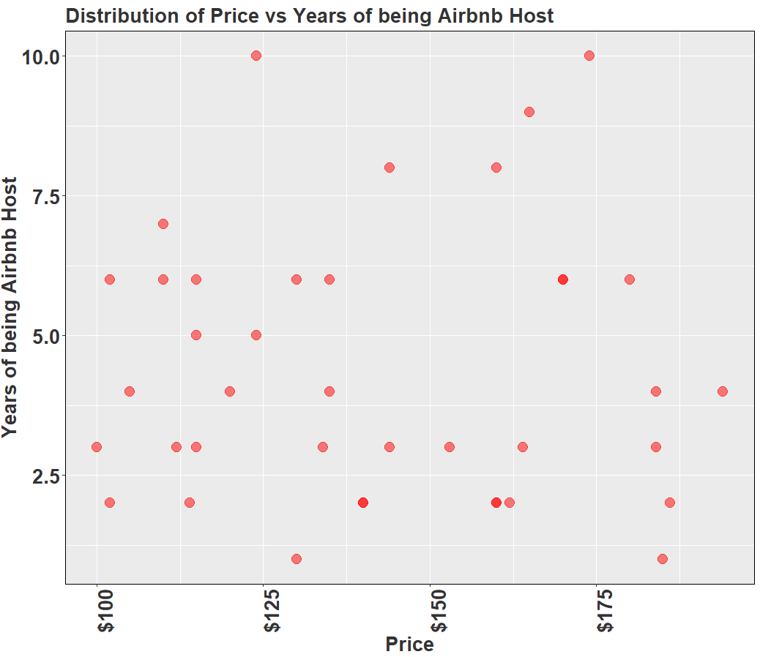
Hawaii: Years of being host vs Price

Slide 22
Top Five
Notes:
Aren’t you VP Student Life?

Slide 23
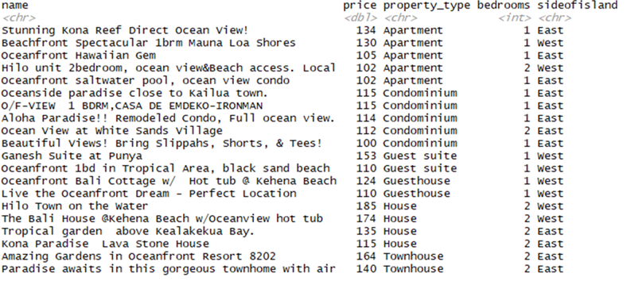
Top 5 Airbnb on Hawaii per Property Type
House and Townhouse most expensive

Slide 24


Top 5 Amenities Requested by Host
Superhost
Host

Slide 25
Summary
Notes:
Aren’t you VP Student Life?

Slide 26
Summary
Started with 16,618 Airbnb
Superhosts 6,776
Hawaii has 39 BeachFront Superhosts on Price Bin [100:150]
The Top 5 by property type are

Slide 27

THANK YOU

